Slide 1
Changing Concepts in Periodontics: What the Dental Clinician Should Know
University of the Pacific
Arthur A. Dugoni School of Dentistry
Annual Alumni Association Meeting
March 9, 2012
William P. Lundergan, DDS, MA

Slide 2


Slide 3
Today’s Topics
Pathogenesis of periodontal disease
Oral health – systemic health connection
Periodontal examination, diagnosis and risk assessment
Periodontal pharmacotherapeutics

Slide 4
Pathogenesis of Periodontal Disease

Slide 5
1970’s Model
Plaque Calculus Pockets Bone loss
Occlusal trauma

Slide 6
1970’s Model
Gingivitis leads to periodontitis if untreated
All individuals equally susceptible
Genetics not a factor in adult periodontitis

Slide 7
Principles of Pathogenesis
Bacterial plaque is essential

Slide 8
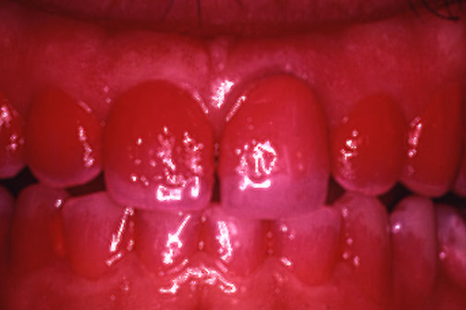
Experimental Gingivitis Model

Slide 9
Nonspecific Plaque Hypothesis
(Plaque Quantity)

Slide 10
Gingivitis Periodontitis

Slide 11
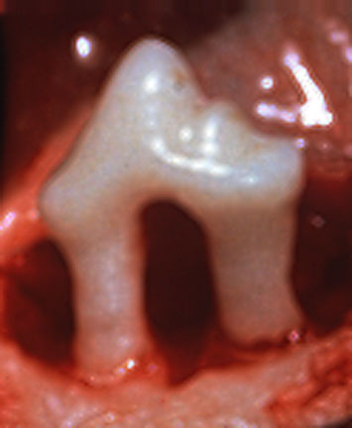
Experimental Periodontitis Model
Conclusion: Conversion from gingivitis to periodontitis cannot be explained by plaque accumulation alone.
(Lindhe, 1976)

Slide 12
Possible Conversion Factors Gingivitis to Periodontitis
Microbiological factors
Host factors

Slide 13
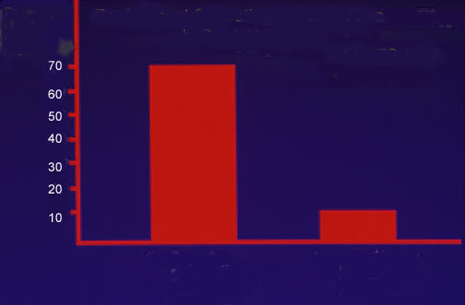
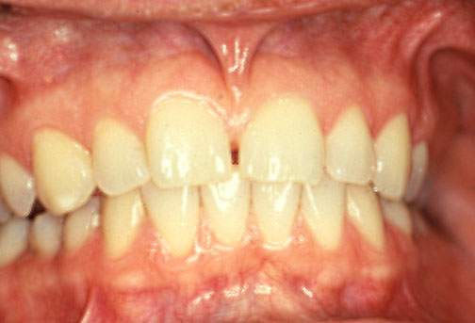
Predominant Cultivable Microbial Flora
in Gingival Health
Percentage of
total viable
bacteria
SLOTS, 1977
G+ Facultative Rods and Cocci Predominantly: Actinomyces Streptococci
G- Anaerobic Rods Predominantly: Bacteroides Fusobacteria

Slide 14
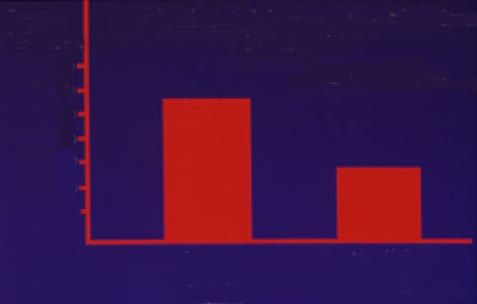
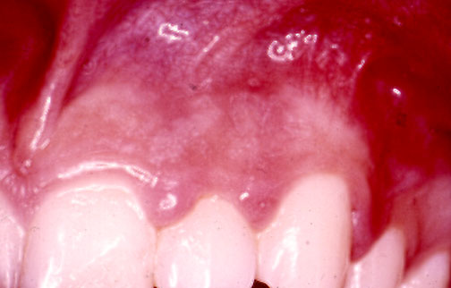
Percentage of total viable bacteria
Predominant Cultivable Microbial Flora in Gingivitis
SLOTS et al. ,1978
70
60
50
40
30
20
10
G+ Facultative Rods and Cocci Predominantly: Actinomyces Streptococci
G- Anaerobic Rods Predominantly: Bacteroides Fusobacteria

Slide 15
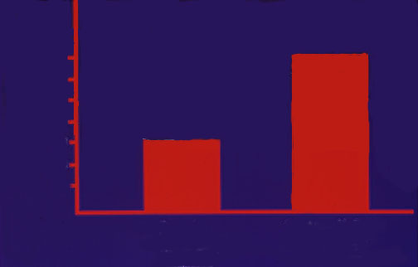
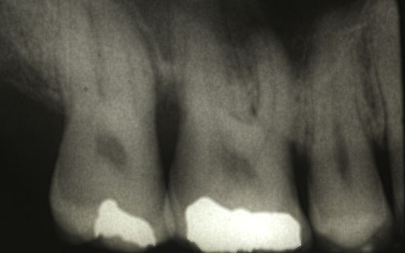
Percentage of total viable bacteria
Predominant Cultivable Microbial Flora in Chronic Periodontitis
SLOTS, 1977
70
60
50
40
30
20
10
G+ Facultative Rods and Cocci Predominantly: Actinomyces Streptococci
G- Anaerobic Rods Predominantly: Bacteroides Fusobacteria

Slide 16
Specific Plaque Hypothesis
(Plaque Quality)

Slide 17
Active Microflora
A. actinomycetemcomitans
P. gingivalis
E. corrodens
P. micros
P. intermedia
F. nucleatum
T. forsythia
T. denticola

Slide 18
Data Suggesting Pathogenicity
Association
Elimination
Host Response
Virulence Factors
Animal Studies

Slide 19
A. naeslundii 2
(A. viscosus)
Subgingival Microbial
Complexes
V. Parvula
A. odontolyticus
S. mitis
S. oralis
S. sanguis
C. rectus
P. Intermedia
R, nigrescens
P. Micros
F. nuc. Vincentii
F. nuc. Nucleatum
F. nuc. Polymorphum
F. periodonticum
C. gracilis
P. gingivalis
B. Forsythus
T. denticola
E. nodatum
Stretococcus sp.
S. Gordonii
S. intermedius
S. constellatus
E. Corrodens
C. Gingivalis
C. Sputigena
C. Ochracea
C. Concisus
A. actino. a
C. showae
A. actino. b
Socransky, J. Clin. Perio, 1998

Slide 20
Biofilms in Peri-Implant Disease
Systematic review
29 papers met criteria
Generally Gm – bacteria similar to CP
Occassional high numbers of peptostreptococci or staphylococci
Mombelli et al J. Clin Perio., 2011

Slide 21
Viruses and Periodontal Disease
EBV – 1 and EBV – 2
HCMV

Slide 22
Herpesviruses in Chronic Periodontitis
40 healthy patients/subgingival samples
40 CP patients/subgingival samples
Identified bacterial pathogens and herpesviruses present
Chalabi et al, Mol. Oral Micro., 2010

Slide 23
Herpesviruses in Chronic Periodontitis (PD > 6mm)
P. gingivalis 95%
T. forsythia 75%
EBV-1 72.5%
CMV 50%
A. actinomycetemcomitans 12.5%
EBV-2 10%
Chalabi et al, Mol. Oral Micro., 2010

Slide 24
Herpesviruses in Chronic Periodontitis
Authors concluded that EBV-1 and CMV may play an important synergistic role in the pathogenesis of chronic periodontitis
Chalabi et al, Mol. Oral Micro., 2010

Slide 25
Viral Mechanism of Action
Immune suppression
Encourage overgrowth of pathogens (enhance attachment)
Interfere with periodontal healing (fibroblast toxicity)
Cytotoxicity (fibroblasts,macrophages, etc.)
Upregulate cytokines

Slide 26
Contagious versus
Transmissible
Strong evidence for familial transmission
Little or no evidence infections are contagious
Transmission of bacteria not synonymous with transmission of disease

Slide 27
Principles of Pathogenesis
1. Bacterial plaque is essential.
2. Clinical signs are result of activated inflammatory and immune mechanisms.

Slide 28
Principles of Pathogenesis
Host Immuno-Inflammatory Response
Connective Tissue and Bone Destruction
Bacterial Challenge
Clinical Signs of Disease

Slide 29
Proinflammatory Mediators
Cytokines
IL–1 IL-6 IL-8 TNF-α
PGE₂
Matrix metalloproteinases (MMP’s)
Leukotrienes

Slide 30
Principles of Pathogenesis
Bacterial plaque is essential.
Clinical signs result of activated inflammatory and immune mechanisms.
Quantity and quality of plaque does not explain severity of disease by themselves.

Slide 31
Sri Lankan Tea Workers (Löe 1986)
81% chronic periodontitis
8% aggressive form
11% no periodontitis

Slide 32
Principles of Pathogenesis
Bacterial plaque is essential.
Clinical signs result of activated inflammatory and immune mechanisms.
Quantity and quality of plaque does not explain severity of disease by themselves.
Host factors influenced by genetic and environmental factors.

Slide 33
Twin Studies
Identical twin studies suggest that more than 40% of the clinical signs of disease severity are the result of genetic factors.
Michalowicz et al, J Perio, 1991

Slide 34
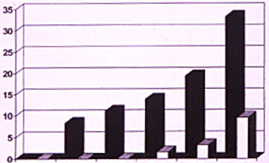
IL-1 Genotype
Cumulative % of subjects with > 30% mean bone loss
Genotype Pos N=36
Genotype Neg N=63
35-40
41-45
46-50
51-55
56-60
>60
AGE
J Clin Perio, 1997

Slide 36
Principles of Pathogenesis
1. Bacterial plaque is essential.
2. Clinical signs result of activated inflammatory and immune mechanisms.
3. Quantity and quality of plaque does not explain severity of disease by themselves.
4. Host factors influenced by genetic and environmental factors.
5. Because of different host responses, treatment may produce different results in different individuals.

Slide 37
Pathogenesis of Periodontitis
Page & Kornman, Periodontol 2000, 1997

Slide 38
Oral Health – Systemic Health Connection

Slide 39
Effect of Systemic Conditions on Periodontal Health
Endocrine Conditions
Hematologic Disorders
Neutrophil Disorders
Smoking
Medication
Stress
Obesity
Nutrition

Slide 40
Diabetes and Periodontal Disease
2,273 Pima Indians
60% prevalence with diabetes
36% prevalence without diabetes
Nelson et al, Diabetes Care, 1990

Slide 41
Diabetes and Periodontal Disease
Poor glycemic control; OR 11.4 for progressive bone loss
Well controlled; OR 2.2
Taylor et al, J. Perio., 1998

Slide 42
Diabetes and Periodontal Disease
AGE - Protein
Macrophage AGE - receptor
Synthesis + Secretion TNF - ∝ + IL –1ß
Degradative cascade

Slide 43
Stress and Periodontal Disease
42,523 male health professionals
40-75 years old at baseline
Daily anger
43% higher risk for developing periodontitis
Merchant et al, JADA, 2003

Slide 44
Stress and Periodontal Disease
Systematic review
14 of 58 articles analyzed
No meta-analysis
57% found a positive relation
29% found a positive and negative relation
14% found a negative relation
Peruzzo et al, J. Perio, 2007

Slide 45
Possible Biologic Mechanisms
Poorer Oral Hygiene
Stress may alter immune response
Neutrophil impairment
Monocyte upregulation

Slide 46
Smoking
Important periodontal risk factor
Increased incidence and severity of periodontitis
Poorer response to therapy
Associated with NUG
Nicotine can impair neutrophil function
Decreased BOP

Slide 47
Relative Risk for Periodontitis Associated with Cigarette Smoking
Current Smoker Odds Ratio
< 9 / day 2.8
10 – 19 / day 3.0
20 / day 4.7
21 – 30 / day 5.1
> 31 / day 5.9
All 4.0
Tomar and Asma, J. Perio, 2000

Slide 48
Obesity and Periodontal Disease
NHANES III database
13, 665 subjects (18-34, 35-59, 60-90 y.o.)
Undergone periodontal examination
BMI and waist circumference
Multivariable logistic regression model
Al-Zahrani et al, J Perio, 2003

Slide 49
Obesity and Periodontal Disease
Significant association for young group (18-34)
OR 1.0 for BMI 18.5-24.9 kg/m² (reference)
OR 1.76 for BMI > 30 kg/m² (P<0.01)
OR 0.21 for BMI < 18.5 kg/m² (P<0.01)
OR 2.27 for high waist circumference (P<0.001)
Al-Zahrani et al, J Perio, 2003

Slide 50
Obesity and Periodontal Disease
Obesity could be a potential risk factor for periodontal disease, especially among younger individuals
Al-Zahrani et al, J Perio, 2003

Slide 51
Low Serum Calcium and Periodontal Disease
NHANES III
11,787 subjects age 20 to 90+
Age groups (20-39; 40-59; 60+)
OR 6.11 for females (20-39 y.o.) P<0.001
OR 2.18 for females 60+ P<0.13
Nishida et al, J. Perio, 2000

Slide 52
2.0
Male
Female
Periodontal Disease Odds Ratio (95% C.I.)
1.5
1.0
0.5
n=1654
n=1504
n=2666
n=2750
n=1813
n=2032
0.0
2-499
500-799
800+
2-499
500-799
800+
Dietary Calcium Intake (mg)
Nishida et al, J. Perio, 2000

Slide 53
Conclusion
Results suggest that low dietary intake of calcium results in more severe periodontal disease
Nishida et al, J Perio, 2000

Slide 54
Vitamin D and Calcium
Cross- sectional study
51 periodontal maintenance patients
23 vitamin D supplements (> 400 IU / day) calcium supplements (> 1000 mg / day)
6.3 to 23 years of supplementation
28 no vitamin D or calcium supplements
Clinical and radiographic measurements taken
Repeated measures multivariate analysis
Miley el al, J. Perio, 2009

Slide 55
Vitamin D and Calcium Intake
Measurement Takers Non-Takers
Probe depths (mm) 2.18 2.33**
LOA (mm) 1.80 2.01**
Bleeding sites (%) 60 66**
Gingival Index 0.73 1.00**
Furcation Involvement / 47 72**
molar sites (%)
Calcium intake (mg/day) 1,769 642*
Vitamin D intake (IU/day) 1,049 156*
* P<0.01
** P>0.05
Miley el al, J. Perio, 2009

Slide 56
Treatment Considerations for Periodontal Patients
Control pathogens
Modulate host response
Smoking cessation program
Good glycemic control
Stress reduction protocol
Weight reduction program
Calcium supplementation
Genetic assessment

Slide 57
Systemic Effects of Periodontitis
Cardiovascular Disease
Pregnancy
Diabetes Mellitus
Respiratory Disease

Slide 58
Cardiovascular Disease and Periodontitis
Suppose you could prevent a heart attack with a 2 minute, no sweat exercise that could be performed anywhere.
Would you be interested?

Slide 59
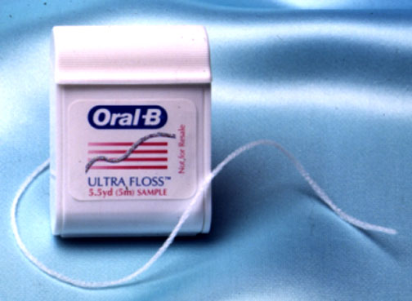
Flossing your teeth might be an exercise that saves your life.

Slide 60
Beck et al, J. Perio., 1996
Cardiovascular Disease / Periodontal Disease
1,147 subject cohort
Systemically healthy at enrollment
18 year follow-up
Bone loss and CHD (OR 1.5)
Bone loss and fatal CHD (OR 1.9)
Bone loss and stroke (OR 2.8)

Slide 61
Other Risk Factors
Cholesterol and CHD (1.6 OR)
Smoking and fatal CHD (1.7 OR)
Smoking and stroke (1.6 OR)
Family Hx. CHD and stroke (3.5 OR)
Annals of Perio, 1996

Slide 62
Incidence of CHD by Level of Oral Bone Loss
%
Age adjusted level of bone loss
Adapted from Beck et al., 1996

Slide 63
Cardiovascular Disease / Periodontal Disease
8032 subjects (NHANES I)
Aged 25 – 74
21 year follow-up
Gingivitis and CHD (OR 1.05)
Periodontitis and CHD (OR 1.14)
Hujoel et al., JAMA, 2000

Slide 64
Biologic Plausibility

Slide 65
Bacteremia and Brushing
290 patients in need of an extraction
Double blind; random assignment to 3 tx. Groups
Brushing / extraction-Amoxicillin / extraction-Placebo
Blood draws at baseline, 1.5 minutes and 5 minutes after initiation and 20, 40, 60 minutes after completion
Circulation, 2008

Slide 66
60
Brushing
Extraction-Amox
Extraction Placebo
50
% Positive Cultures
40
30
20
10
0
1
2
3
4
5
6
Draw

Slide 67
Cardiovascular Disease / Periodontal Disease
50 atheromatous plaque specimens
(endarterectomy)
70% atheromas were positive for bacterial DNA
44% positive for periodontal pathogens
  30% T. forsythia
  26% P. gingivalis
  18% A. actinomycetemcomitans
Haraszthy et al., J. Perio, 2000

Slide 68
Systemic exposure to bacteria, endotoxin, and cytokines of periodontal origin may contribute to atheroma development and thromboembolic phenomena.
LPS
Upregulates endothelial adhesion molecules
Releases cytokines favoring coagulation and thrombosis
Retards fibrinolysis
Enhances smooth muscle proliferation

Slide 69
Chewing & Endotoxemia
40% of patients with Periodontitis positive
12% of perio healthy patients positive
Serum concentration of endotoxin 5x greater in periodontitis patients
Geerts et al, J. Perio 2002

Slide 70
Monocytic/Lymphocytic Response Trait
Genetic Factors
Environmental Factors
Hyperinflammatory Phenotype
Periodontal Pathogens
Periodontal Disease
Atherosclerosis Predisposition
Microbial and LPS exposure
PGE₂ , IL-β TNF-∝
Other Risk Factors
Vascular Effects
Endothelium
Smooth muscle
Platelets
Atherosclerotic lesion development
Thrombroembolic events
Beck et al, Annals of Perio, 1998

Slide 71
Periodontal Disease and Cardiovascular Disease
Systematic review
31 studies analyzed
Different oral assessment measures
No meta-analysis
Scannapieco, Annals of Perio, Dec. 2003

Slide 72
Consensus Report:
There is moderate evidence to suggest that periodontal disease is associated with cardiovascular disease, however, causality is unclear
There is currently insufficient evidence to show that treatment of periodontal disease reduces the risk of heart disease
Annals of Perio, Dec. 2003

Slide 73
Endothelial Function & Periodontal Treatment
114 subjects with 30% bone loss on over 50% of their teeth and PD over 6mm
(Control) OHI / Supragingival plaque removal
(Test) Sc/RP with anesthesia; selective extraction; Arestin
Brachial artery dilatation / flow measurement
Tonetti et al, N Eng J of Med, 2007

Slide 74
Endothelial Function & Periodontal Treatment
Sc/RP led to short term (24 hr.) systemic inflammation & endothelial dysfunction.
Six month endothelial function was improved compared to the control (P<0.001).
Tonetti et al,
N Eng J of Med, 2007

Slide 75
Periodontal Disease and Carotid Plaque
FDG – PET measures metabolic activities in human tissues
Hypothesis: metabolic activities in periodontal tissue predicts inflammation in remote atherosclerotic vessels
Fifer et al, J. Am. Coll. Cardiology, 2011

Slide 76
Periodontal Disease and Carotid Plaque
112 patients underwent FDG – PET imaging
Measured uptake in periodontal tissues and carotid / aorta vessels
16 patients underwent carotid endarterectomy within 1 month of imaging
Fifer et al, J. Am. Coll. Cardiology, 2011

Slide 77
Periodontal Disease and Carotid Plaque
Periodontal FDG uptake associated with carotid (R=0.64) and aortic (R=0.38) uptakes
Strong relationship (R=0.81) between periodontal uptake and histologically assessed inflammation (macrophage infiltration) within excised carotid artery plaques
Fifer et al, J. Am. Coll. Cardiology, 2011

Slide 78
Periodontal Disease and Carotid Plaque
Authors concluded this study may set the stage for future investigations regarding the effect of treatment of periodontal disease on carotid plaque inflammation.
Fifer et al, J. Am. Coll. Cardiology, 2011

Slide 79
Periodontal Disease and Preterm Birth
124 women
< 2,500 gm. Birth
< 37 weeks gestational age
Preterm labor
Premature rupture
Periodontal disease and PLBW (OR 7.9)
Offenbacher et al; J. Perio, 1996

Slide 80
Risk Factors for PLBW Mothers
Periodontitis
Alcohol
African-American
Age
Parity
Treated BV
0
1
2
3
4
5
6
7
8
Odds Ratio
Annals of Perio, 1998

Slide 81
Biological Plausibility
Periodontal Disease
Inflammatory Response
Mediators PGE₂ TNF-∝
Uterine Contraction Cervical Dilation

Slide 82
Experimental Periodontitis / Hamster Model
Mean Litter Weight {g}
Control Control Chow Chow+P.ging
+ P. ging
Annals of Perio., 1998
Periodontitis

Slide 83
Experimental Periodontitis / Hamster Model
Intraamniotic Levels (ng/mL)
PGE₂
PGE₂
TNF- α
TNF-α
Annals of Perio., 1998

Slide 84
Oral Conditions and Pregnancy
5 yr. Prospective study
Full mouth perio exam
812 deliveries
566 mild periodontitis
45 moderate to severe periodontitis
201 healthy
Annals of Perio, 2001

Slide 85
Maternal Antepartum Periodontal Status
*
†
BW (g)
% of Births
* P = 0.0006
† P <0.0001
Annals of Perio, 2001

Slide 86
Percent of Fetal IgM Responses Against Orange and Red Complex Organisms Among Term and Preterm Neonates
Term Preterm
Organisms (n = 271) (n = 80) P Value
Orange Complex C. Rectus P. Intermedia | 6.3 1.1 | 20.0 8.8 | 0.0002 0.0003
Red Complex P. Gingivalis B. Forsythus T. Denticola | 16.2 10.7 8.1 | 16.3 20.0 17.5 | >0.05 0.03 0.015
Annals of Perio, 2001

Slide 87
Periodontal Disease and Adverse Pregnancy Outcomes
Systematic review
12 studies analyzed
No meta analysis
Scannapieco et al, Annals of Perio., Dec. 2003

Slide 88
Consensus Report:
There is moderate evidence to suggest that periodontal disease is associated with adverse pregnancy outcomes, however causality is unclear
There is currently limited evidence to recommend that patients undergo periodontal treatment to reduce the risk of adverse pregnancy outcomes
Annals of Perio., Dec. 2003

Slide 89
Periodontal Therapy and Preterm Birth
N = 870 women (Santiago, Chile) with periodontal disease
Baseline exam
Random assignment
Treatment before 28 weeks or after delivery
OHI daily CHX rinses, mechanical debridement, 2-3 week maintenance (18% systemic antibiotics)
Control group monitored at 4-6 weeks
Lopez et al, JP, 2005

Slide 90
Periodontal Therapy and Preterm Birth
2.1% (12/560) preterm (treatment group)
6.7% (19/283) preterm (control group)
OR 2.76; p = 0.008
Lopez, JP, 2005

Slide 91
Preterm Birth & Periodontal Treatment
Multi-centered / randomized
823 women
“essential” dental care for all
413 women received Sc/RP
No significant difference between groups in mean gestational age
Michalowicz et al,N Eng J of Med, 2006

Slide 92
Mouth Rinse and Preterm Birth
204 women 6-20 weeks gestation
All had periodontal disease diagnosis
All refused standard dental care
Random group assignment
Blinded examiners
Jeffcoat, IADR, 2011

Slide 93
Mouth Rinse and Preterm Birth
49 subjects used Crest Pro-Health rinse
155 used identical bottles of water
No significant difference in tobacco or alcohol use between groups
Preterm birth defined as less than 35 weeks
Jeffcoat, IADR, 2011

Slide 94
Mouth Rinse and Preterm Birth
6.1% preterm birth (test group)
21.9% preterm birth (control group)
P < 0.01
Periodontal disease remained constant in test group
Periodontal disease progressed in the control group
Jeffcoat, IADR, 2011

Slide 95
Diabetes and Periodontal Disease
Periodontitis may adversely affect glycemic control in diabetes
Control of periodontal inflammation may reduce medication needed for glycemic control.

Slide 96
Treatment of Periodontal Disease in Diabetes
Thorough root cleaning
Doxycycline 100 mg daily / 2 wks.
12 Months Post-Treatment
Improved CAL
Reduced PD
Improved glycemic control
Grossi et al, J. Perio, 1997

Slide 97
After Periodontal Treatment
No Doxycycline
Doxycycline
P. Gingivalis positive
P. Gingivalis negative
Mean Change of HbA_{1C} (%)
Grossi et al, J. Perio, 1997

Slide 98
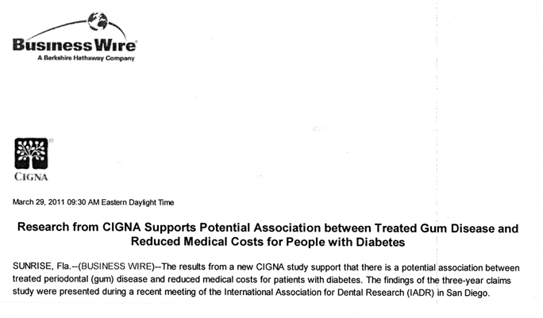

Slide 99
CIGNA Study
3 year study reviewing CIGNA records
46,094 individuals aged 18-62
3,449 received treatment for diabetes
IADR, 2011

Slide 100
CIGNA Study
Group 1: perio treatment at baseline and regular maintenance (1,355)
Group 2: perio treatment prior to baseline without regular maintenance (2,094)
Group 2 had average medical cost of $2,483.00 per patient greater than Group 1
IADR, 2011

Slide 101
Periodontal Disease & Respiratory Disease
Nursing home residents
Oral care vs. no oral care
11% vs. 19% incidence of pneumonia
8% vs. 16% pneumonia related mortality
Yoneyama et al, J. Am. Geriatr. Soc., 2002

Slide 102
Oral Hygiene Intervention / Pneumonia
Systematic review
Meta-analysis / odds ratios
N=497 (5 studies); OR=3.7
Scannapieco et al, Annals of Perio., Dec. 2003

Slide 103
Consensus Report
Moderate evidence suggests that the incidence of noscomical pneumonia in institutionalized subjects, including those of intensive care units and nursing homes, may be reduced by improving oral hygiene, which can be achieved by both mechanical or chemical approaches
Annals of Perio., Dec. 2003

Slide 104
We must now consider that periodontal infections may also play a significant role in systemic health.
Summary

Slide 105
Periodontal Examination, Diagnosis and Risk Assessment

Slide 106
Non-diagnosis, under treatment and inappropriate treatment of periodontal disease are major causes of tooth loss.

Slide 107
All patients must be screened on a regular basis, with comprehensive exams when disease is detected.

Slide 108
Periodontal Screening and Recording (PSR)
Screening exam designed jointly by the AAP and ADA
Promotes early detection and tx
Allows rapid assessment and recording
Does not replace the need for a comprehensive periodontal exam

Slide 109

W.H.O. probe
0.5 mm ball tip
3.5 mm and 5.5 mm markings
Scores by sextant
Six sites per tooth
Highest score recorded per sextant
An * added if other clinical abnormalities

Slide 110
Parameters of Care
Periodontal examination
Periodontal diagnosis
Informed consent
Re-evaluation
Periodontal maintenance
J. Perio Supplement, May 2000

Slide 111
Parameter on Comprehensive Periodontal Examination:
Med. Hx.
Dent. Hx.
EOE & IOE
Radiographs (current)
Teeth evaluated (caries, mobility, etc.)
Plaque and calculus presence and distribution
Parameters of Care, 2000

Slide 112
Parameter on Comprehensive Periodontal Examination:
PD, GM, BOP evaluated
Mucogingival relationships
Furcations (presence, location, extent)
Clinical findings documented
Referral when warranted
Parameters of Care, 2000

Slide 113
Diagnosis should be based on clinical attachment level and not probing depth.

Slide 114
Probing Depth Measurement
Rapidly recorded
Good assessment of disease distribution in patient
Limited diagnostically
Essential part of complete exam

Slide 115
Clinical Attachment Loss Measurements
Difficult to measure
Important diagnostic value
Most valued assessment of treatment outcome

Slide 116
Clinical Attachment Level Assessment
Facial / lingual (locate CEJ / perio probe)
Interproximal (look at radiograph); clinically estimate CEJ based on facial and lingual location

Slide 117
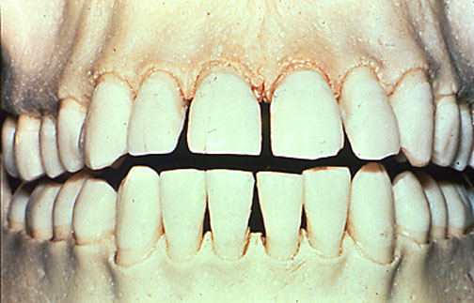
Normal Osseous Form

Slide 118
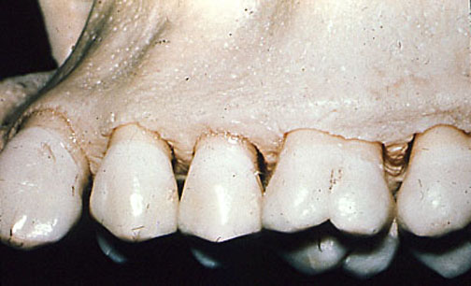
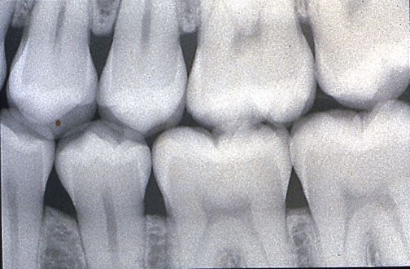
Normal bone
Radiographically normal bone height

Slide 119
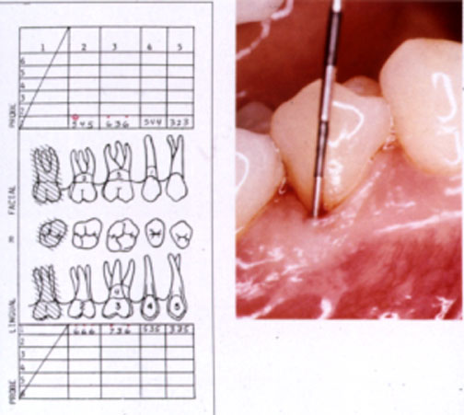
Bleeding on Probing (BOP)
Indicates inflammation
Not reliable predictor LOA

Slide 120
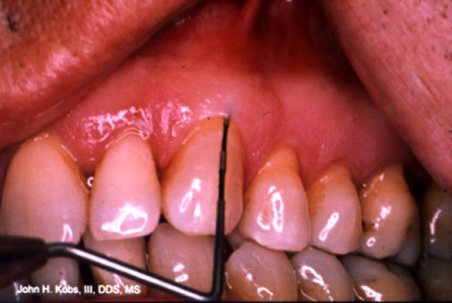
No Bleeding on Probing
Reliable predictor no LOA
Repeated absence highly predictive

Slide 121
Smoking and Bleeding
NHANES III survey
12,385 individuals
141,967 sites
Dietrich et al, J.P. 2004

Slide 122
Weighted Odds Ratio (OR) from the Main Effects Model*
Smoking Status OR
Never 1.00
Former 0.78
Current (cigarettes/day)
< 10 0.53
11 – 20 0.40
21 – 30 0.33
> 30 0.44
* Adjusted for age, gender, race/ethnicity, calculus, probing depths, poverty / income ratio, tooth / jaw, number of missing teeth, full crown coverage, root caries, dental examiner, survey phase, stratum, and PSU.

Slide 123
PD 0-3 mm
6
5
no calculus
supra
4
sub / supra
OR
3
2
1
0
Never Former Light Heavy
Weighted OR estimates showing the effect of smoking status on gingival bleeding by calculus for sites with probing depths (PD) of 0 to 3 mm (reference: sites with PD 0 to 3 mm without calculus in never-smokers).

Slide 124
PD > 4 mm
6
5
no calculus
supra
4
sub / supra
OR
3
2
1
0
Never Former Light Heavy
Weighted OR estimates showing the effect of smoking status on gingival bleeding by calculus for sites with probing depths (PD) of > 4 mm (reference: sites with PD 0 to 3 mm without calculus in never-smokers).

Slide 125
Smoking and Bleeding
Bleeding on probing reduced nearly 50% in smokers
Effects strongest in heavier smoker
Smallest in former smokers
May mask periodontal disease
Dietrich et al, J.P. 2004

Slide 126
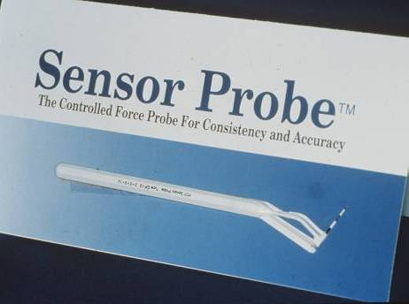
Implant Assessment
Plastic probes are used when checking for evidence of disease.

Slide 127
Implant Baseline Examination
Baseline radiographs
Baseline probing assessment
Seventh European Workshop on Periodontology
J. Clin. Perio. 2011

Slide 128
Maintenance Visits
Occlusion - verify there are no excursive contacts. Should not have contact in light occlusion but mark with hard biting.
Oral hygiene - same requirements as for natural teeth.
Soft tissue health - periodontal probing for evidence of disease (check BOP each recall).
Screw joint torque - check for loosened screws (most common problem).
Integrity of attachments - applies to overdenture / overpartials.
Stability of implants - must be stable (non mobile) to be successful
Crestal bone level – annual radiographs

Slide 129
Biologic Parameters
Microbial Analysis
  Culture
  DNA probe
Genetic Susceptability
  IL-1
GCF analysis
  Host derived enzymes
  Inflammatory mediators
  Tissue breakdown products
Neutrophil Function Assays
  Chemotaxis
  Phagocytosis

Slide 130
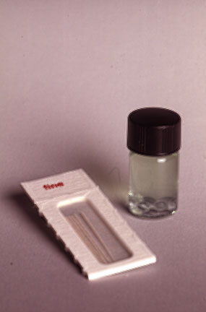
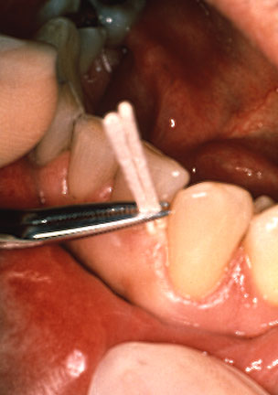
Microbial Analysis

Slide 131
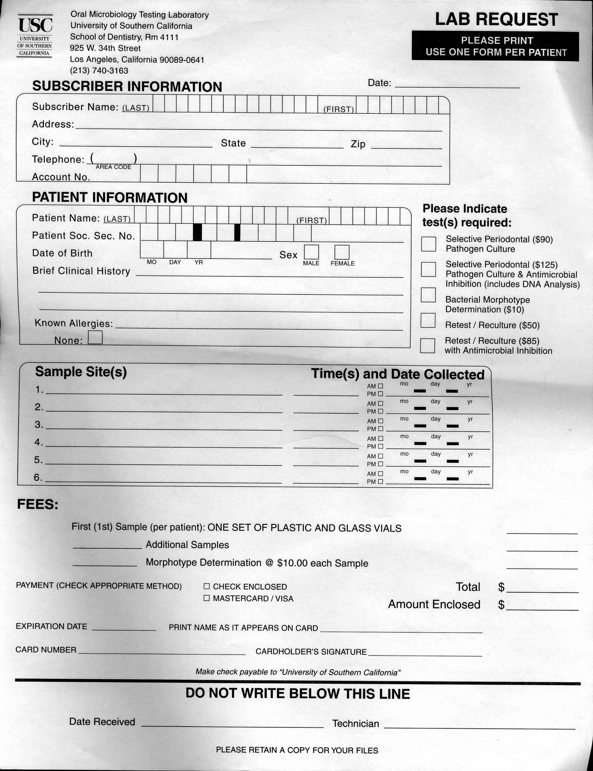

Slide 132
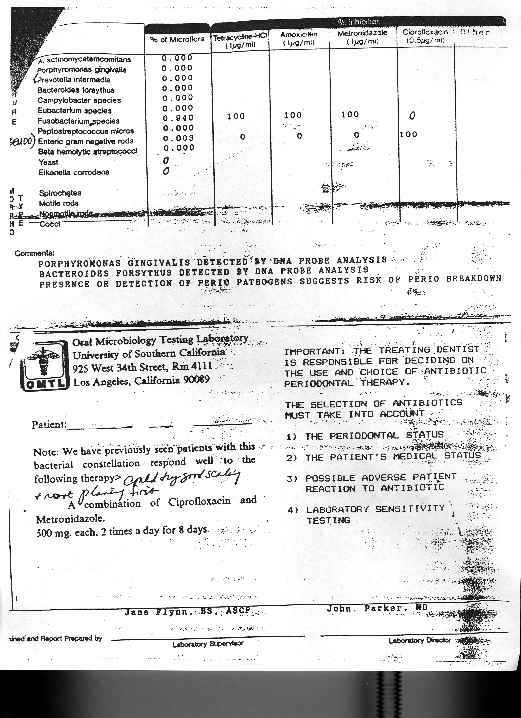

Slide 133
A diagnosis and treatment plan should be presented to the patient.
Parameters of Care, 2000

Slide 134
Parameter on Comprehensive Periodontal Examination:
Informed consent
  Diagnosis
  Treatment alternatives
  Potential complications
  Expected results
  Consequences of no treatment
  Patient responsibilities
Parameters of Care, 2000

Slide 135
Periodontal Pharmacotherapeutics

Slide 136

Periodontal Pharmacotherapeutics
Topical
Local
  Irrigation
  Sustained release
Systemic

Slide 137
Comparison of Drug Delivery Systems for Management of Periodontitis
Mouth Subgingival Systemic Controlled Rinse Irrigation Delivery Delivery
Reaches site of
disease activity Poor Good/Poor Good Good/Poor
Adequate drug
concentration Good Good Fair/Good Good
Adequate duration
of therapy Poor Poor Fair/Good Good

Slide 138
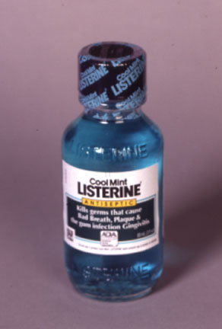
Topical Delivery
First Generation Antimicrobial

Slide 139
Antimicrobial Agents
Phenolic compounds
Peroxide
Enzymes
Fluoride
Quaternary ammonium compounds
Sanguinarine
Alexidine
Octinidine
Chlorhexidine
Triclosan / Copolymer

Slide 140
Antimicrobial Spectrum of Antiseptic Agents
Group Gram positive Gram negative Fungi Viruses
Alcohol +++ +++ +++ +++
Chlorhexdine +++ ++ + +++
Iodine +++ +++ ++ +++ compounds
Iodophors +++ +++ ++ ++
Phenol +++ + + + derivatives
Triclosan +++ ++ - +++
Quaternary + ++ - + ammonium compounds
Note:
+++ = excellent ++ = good + = fair - = no activity or not sufficient
CDC 2004

Slide 141
1,000
Mouthwash
(No Substantivity)
100
Salivary Concentration ug/ml
10
Expectoration

Slide 142
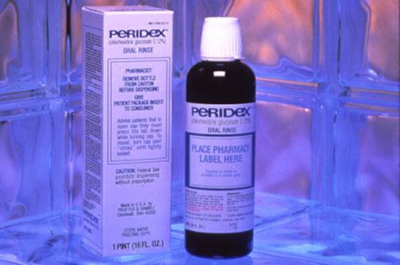
2nd Generation Antimicrobial

Slide 143
Substantivity
1000
Chlorhexidine (Substantivity)
Salivary Concentration ug/ml
100
10
12 hours
Expectoration

Slide 144
Plaque Index
Lang and Brecx, JPR 1986
2
1
0
0
7
14
21
DAYS
0.12% CHX
0.075% CPC
Sanguinarine
Placebo
Listerine

Slide 145
Gingival Index
2
Lang and Brecx, JPR 1986
1
0
0
7
14
21
0.12% CHX
DAYS
Placebo
sanguinarine
Listerine
0.075% CPC

Slide 146
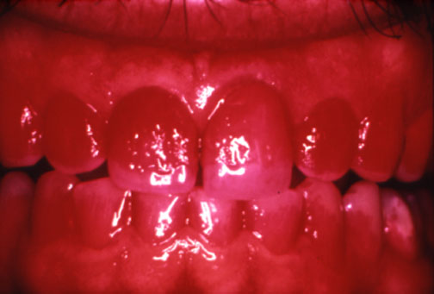
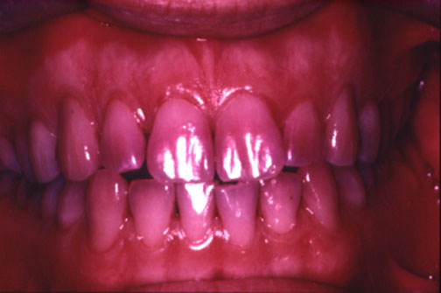
Control
(10 days)
Octinidine (10 days)

Slide 147
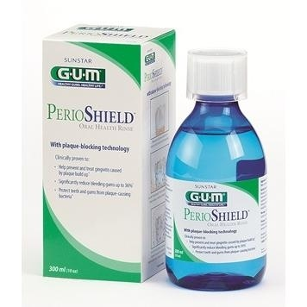
New Product
Delmopinol HCl 0.2%
PerioShield / Sunstar
Reduce viscosity of plaque glucans
Forms barrier interfering with bacterial aggregation and colonization

Slide 148

Total® Toothpaste
Triclosan
Copolymer PVM/MA

Slide 149
Total®
Dual antibacterial/anti-inflammatory action
12 hrs antibacterial action
27% plaque reduction
57% gingivitis reduction
37% decrease in supragingival calculus

Slide 150
Membrane Phospholipids
Phospholipase A₂
Arachidonic Acid
Cox 1 & 2
5 - lipoxygenase
Cell-Cell interaction
Triclosan
Triclosan
Prostaglandins
Leukotrienes
Lipoxins

Slide 151
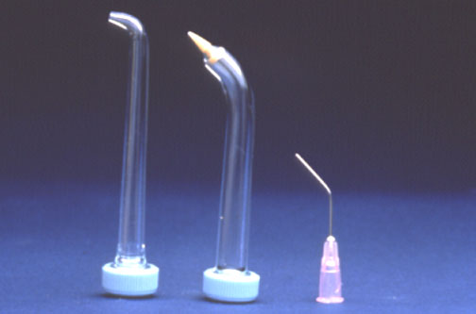
Local Delivery
Irrigation

Slide 152
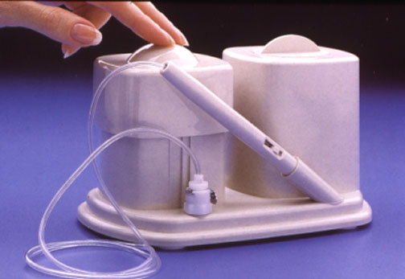
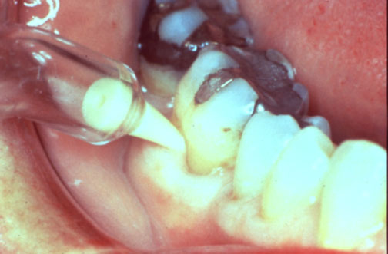
Patient Delivered Irrigation

Slide 153
Professional Irrigation

Slide 154
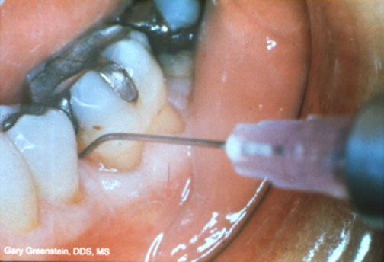
How far subgingivally do irrigants extend?
Supragingivally – only a few millimeters at best
Subgingivally – much more

Slide 155
Consensus Report:
There is strong evidence for a lack of an adjunctive benefit of therapist delivered chlorhexidine irrigation during SRP to achieve reductions in PD and BOP in patients with chronic periodontitis
Annals of Perio, Dec. 2003

Slide 156
Local Sustained Release
Actisite
PerioChip
Atridox
Arestin

Slide 157
Local Sustained Release
May produce marginal improvements in:
  Attachment levels
  Probing depths
  Gingival bleeding

Slide 158
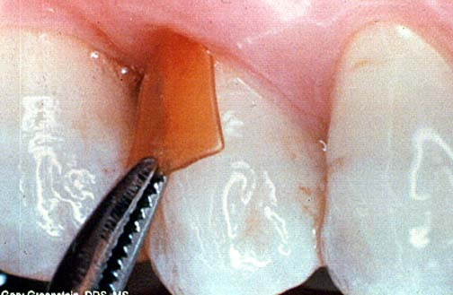
Perio Chip ®
2.5 mg chlorhexidine gluconate
4 mm x 5 mm x 350 um chip
<1 minute to insert
No bacterial resistance
Controlled release
Bioabsorbable

Slide 159
Pharmacokinetics
40% released within 24 hrs.
>1,000 ug/ml at 4 hrs.
480 ug/ml at 3 days

Slide 160
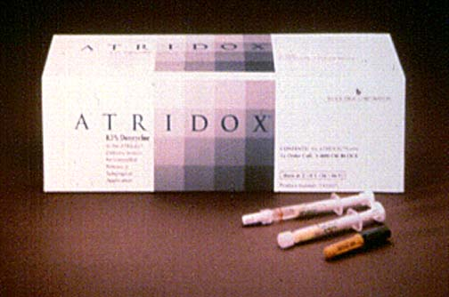
Atridox®
Controlled –release product
Doxycycline hyclate (10%)
50 mg doxycycline
2 syringe system
Coe-Pak/Octyldent
Bioabsorbable

Slide 161
Doxycycline
Broad-spectrum
Bacteriostatic
MIC₉₀ < 6.0 ug/ml

Slide 162
Pharmacokinetics
Time (Hours)

Slide 163
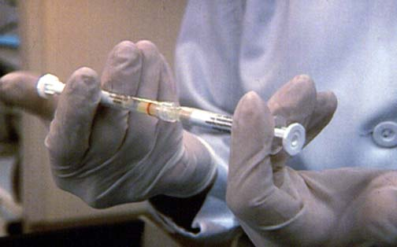

Slide 164
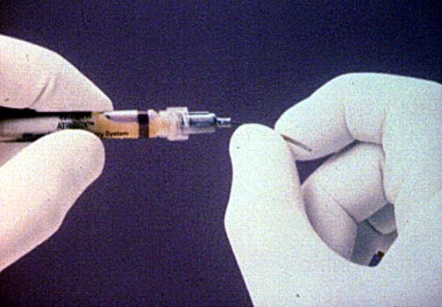

Slide 165
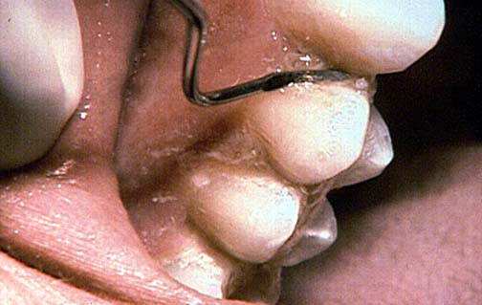

Slide 166
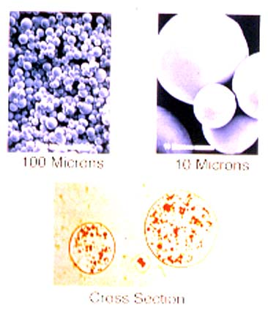
Arestin
minocycline 1 mg.
microsphere technology
bioabsorbable
easy to place/use
  No reconstitution
  No refrigeration
sustained drug delivery

Slide 167
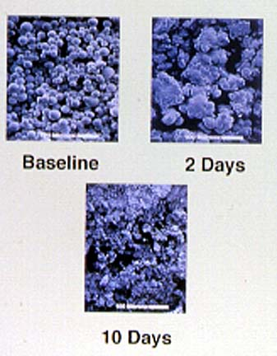
Arestin Polymer PGLA
Characteristics
Bioadhesive
  No retentive dressing necessary
Bioabsorbable
  Hydrolyzes to CO2 and H2O – nothing to remove
Proven Safety
  Suture Material

Slide 168
Minocycline
Potent, broad spectrum antibiotic
Semi-synthetic derivative of tetracycline
Effective against periodontal pathogens
  Periodontal Pathogens MIC₉₀
  (mcg/ml)
  Bacteroides 4
  Porphyromonas Gingivalis 1
  Actinobacillus Actinomycetemcomitams 4
  Prevotella Intermedia 4
  Treponema Denticola 0.06

Slide 169
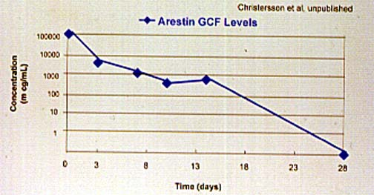
Pharmacokinetics

Slide 170
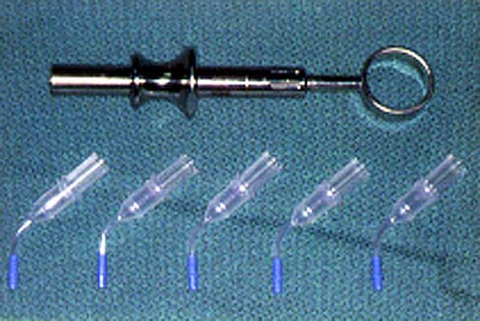
How To Use
Chair-side Preparation

Slide 171
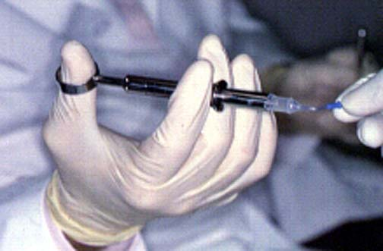
How To Use
Remove Tip from Cartridge

Slide 172
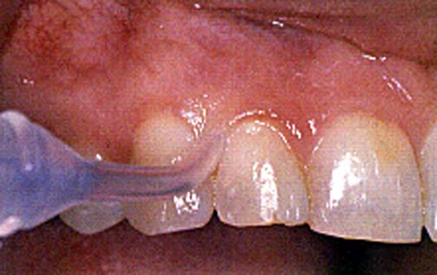
How To Use
Place Subgingivally

Slide 173
Probing Depth Reduction (Clinical Attachment Gain) With Local Drug Delivery (mm)
Study N SC/RP Combined Number of Applications
Chlorhexidine Chips
Jeffcoat et al 447 0.64 (0.51) 0.95 (0.75) 1 to 3
Soskolne et al 118 0.70 (0.31) 1.16 (0.47) 2
Minocycline Microsphere
Williams et al 696 3
Probing depth > 5 mm 1.08 1.32
Probing depth > 6 mm 1.05 1.46
Probing depth > 7 mm 0.98 1.99
Doxycycline Hyclate
Garret et al 411 1.3 (0.8) 1.3 (0.9) 2
411 0.9 (0.8) 1.1 (0.9) 2

Slide 174
Local Anti-Infective Therapy: Pharmacological Agents
Systematic review
32 studies
Patient’s with chronic periodontitis
Meta-analysis for PD and CAL
Scannapieco et al, Annals of Perio., Dec. 2003

Slide 175
Consensus Report:
There is moderate evidence to demonstrate a statistically significant benefit associated with the adjunctive use of minocycline microsphere, combined with SRP to achieve additional PD reduction
Annals of Perio, Dec. 2003

Slide 176
Consensus Report:
There is moderate evidence to demonstrate a statistically significant benefit associated with the adjunctive use of chlorhexidine chip and doxycycline gel combined with SRP for additional CAL gain
Annals of Perio, Dec. 2003

Slide 177
Consensus Report:
There is strong evidence that the adjunctive use of local delivery anti-infective intracrevicular agents combined with SRP does not result in significant patient centered adverse events.
Annals of Perio, Dec. 2003

Slide 178
Systemic Therapy
Antibiotics
Probiotics
Host modulation

Slide 179
Antibiotic Therapy
Systemic antibiotics may be indicated for:
Aggressive periodontitis
Refractory periodontitis
Acute infections
Diabetes
Implants

Slide 180
Antibiotic Therapy
Systemic antibiotics not indicated for:
Chronic periodontitis
NUG

Slide 181
Typical Antibiotics Used For Treating Periodontitis
Drug Adult Dose
Metronidazole
Ciprofloxacin
Metronidazole & amoxicillin
Metronidazole & ciprofloxacin
Doxycycline
Clindamycin
500 mg/TID/8 days
500 mg/BID/8 days
250 mg/TID/8 days of each drug
500 mg/BID/8 days of each drug
100 – 200 mg/QD/21 days
300 mg/TID/8 days
Position Paper (AAP) J Perio, 2004

Slide 182
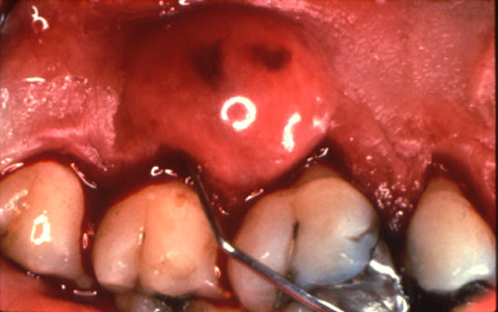
Periodontal Abscess

Slide 183
Amoxicillin
Typical Antibiotics Used for Treating a Periodontal Abscess
1.0 g. LD; 500 mg., t.i.d.; 3 days
Azithromycin
1.0 g. LD; 500 mg. daily on days 2 and 3
Clindamycin
600 mg. LD; 300 mg; q.i.d.; 3 days
Position Paper (AAP) J Perio, 2004

Slide 184
Probiotics and Periodontal Disease
66 medically healthy volunteers without severe periodontitis
Random assignment / double blind
Lactobacillus salivarius and Xylitol tablet (n=34)
Placebo Xylitol tablet (n=32)
T.I.D. for 8 weeks
Mayanagi et al, J Clin Perio, 2009

Slide 185
Probiotics and Periodontal Disease
Supragingival and subgingival plaque samples taken at baseline, 4 wks., and 8 wks. for 5 periodontal pathogens
Numerical sum of pathogens in test group subgingival plaque was decreased significantly at 4 wks (OR=3.13; p=0.012)
Tannerella forsythia lower subgingivally in test group vs. placebo at 4 wks (OR=6.69; p<0.001) and 8 wks (OR=3.67; p=0.006)
Mayanagi et al, J Clin Perio, 2009

Slide 186
Host Modulation Therapy

Slide 187
Pathway to Periodontal Disease

Slide 188
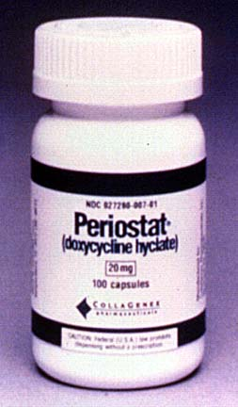
Periostat
Doxycycline hyclate
20 mg. Capsules
Twice daily
Chronic dosing

Slide 189
Periostat
Adjunct to Sc/RP
Anti-collagenase activity
No shift in microflora
No emergence of resistant flora

Slide 190
Sub-Antimicrobial Dose Doxycycline (SDD)
Systematic review
Patients with chronic periodontitis
SDD with Sc/RP vs. Sc/RP alone
Meta-analysis CAL and PD
N=691 (6 studies) / PD 4-6mm / CAL  0.44mm / PD  0.45
N=664 (5 studies) PD > 7mm / CAL  0.45mm / PD  0.48
P < 0.005
Reddy et al, Annals of Perio, Dec. 2003

Slide 191
Consensus Report:
There is strong evidence supporting the use of SDD as an adjunct to conventional therapy in the management of chronic periodontitis
Annals of Perio, Dec. 2003

Slide 192
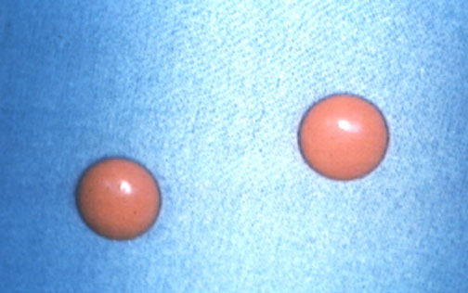
NSAID’s
Indomethacin
Flurbiprofen
Ibuprofen
Naproxen
Ketoprofen

Slide 193
NSAID’s
Decreases rate of bone loss
Decrease BOP
Decrease gingival inflammation
Inhibit LOA

Slide 194
Membrane Phospholipids
Phospholipase A₂
Arachidonic Acid
Cox 1 & 2
5 - lipoxygenase
Cell-Cell interaction
NSAID’s
Ketoprofen
Prostaglandins
Leukotrienes
Lipoxins

Slide 195
Bisphosphonates
Alendronate vs. placebo
40 subjects with periodontitis
Double blind, randomized
Subtraction radiography
0.45 relative risk of progressive bone loss for alendronate
Jeffcoat et al, 1996

Slide 196
THE END

